Slide 1
ME16A: CHAPTER ONE
STATICALLY DETERMINATE STRESS SYSTEMS

Slide 2
INTRODUCTION
A problem is said to be statically determinate if the stress within the body can be calculated purely from the conditions of equilibrium of the applied loading and internal forces.

Slide 3
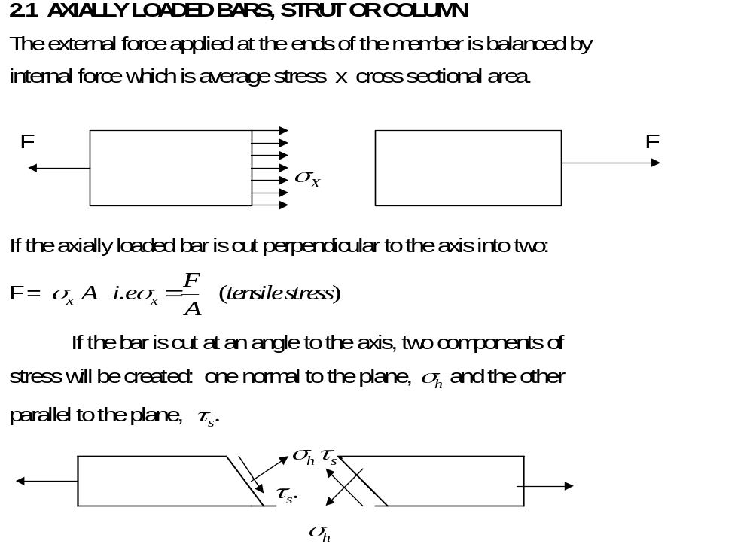
2.1 AXIALLY LOADED BARS, STRUT OR COLUMN

Slide 4
2.1.1. Principle of St. Venant
It states that the actual distribution of load over the surface of its application will not affect the distribution of stress or strain on sections of the body which are at an appreciable distance (> 3 times its greatest width) away from the load

Slide 5
Principle of St. Venant Contd.
e.g. a rod in simple tension may have the end load applied.
(a) Centrally concentrated
(b) Distributed round the circumference of rod
(c) Distributed over the end cross-section.
All are statically equivalent.

Slide 6
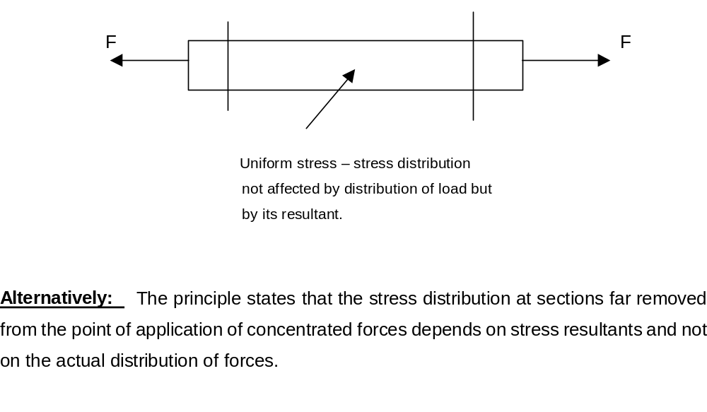
Principle of St. Venant Concluded

Slide 7
Example
The piston of an engine is 30 cm in diameter and the piston rod is 5 cm in diameter. The steam pressure is 100 N/cm².
Find (a) the stress on the piston rod and
(b) the elongation of a length of 80 cm when the piston is in instroke.
(c) the reduction in diameter of the piston rod (E = 2 x 10⁷ N/cm²; v = 0.3).

Slide 8
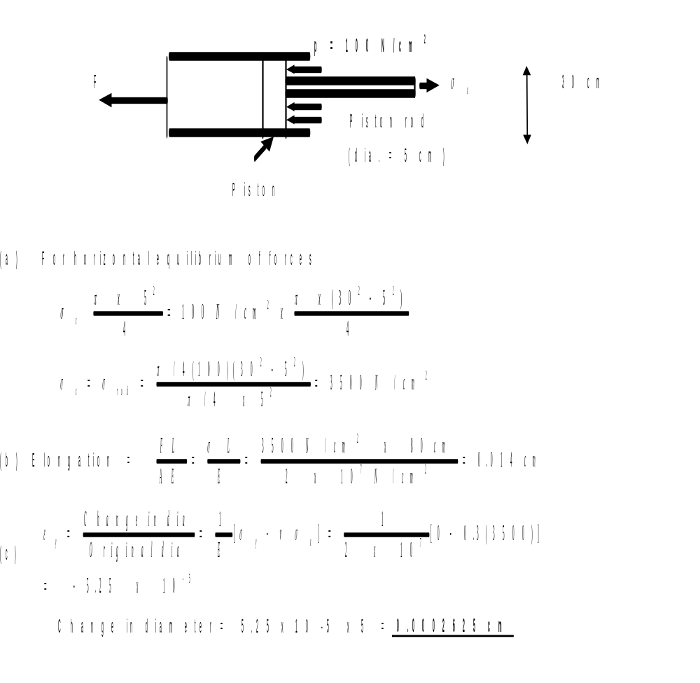
Solution

Slide 9
2.2 THIN-WALLED PRESSURE VESSELS
Cylindrical and spherical pressure vessels are commonly used for storing gas and liquids under pressure.
A thin cylinder is normally defined as one in which the thickness of the metal is less than 1/20 of the diameter of the cylinder.

Slide 10
THIN-WALLED PRESSURE VESSELS CONTD
In thin cylinders, it can be assumed that the variation of stress within the metal is negligible, and that the mean diameter, D_{m} is approximately equal to the internal diameter, D.
At mid-length, the walls are subjected to hoop or circumferential stress, and a longitudinal stress, .

Slide 11
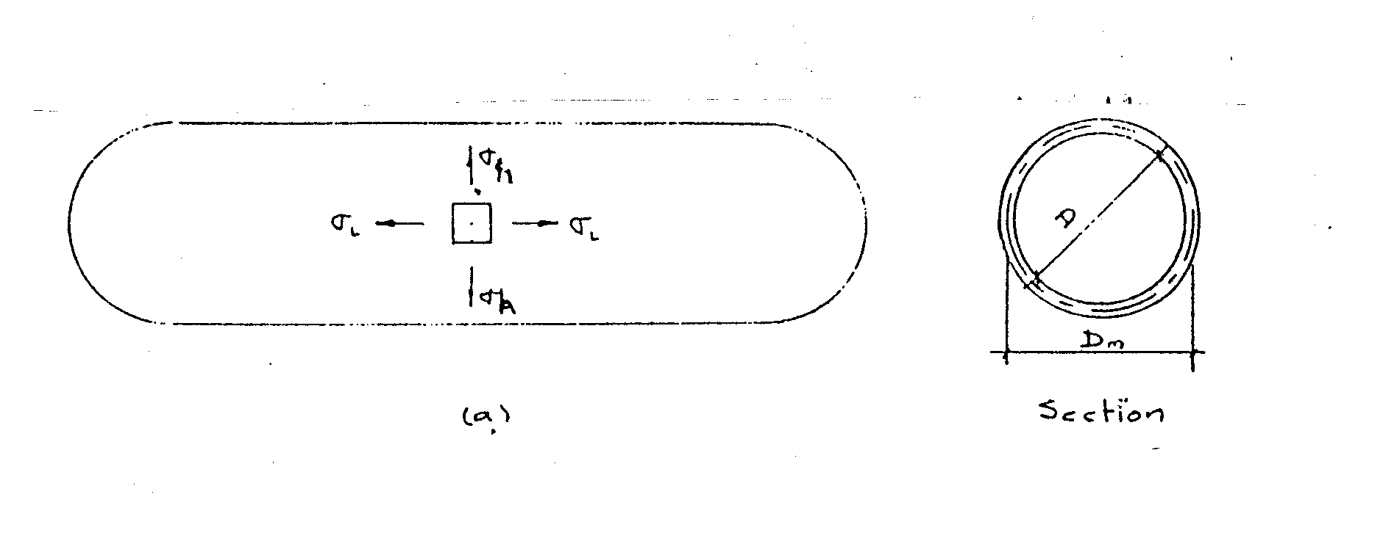
Hoop and Longitudinal Stress

Slide 12
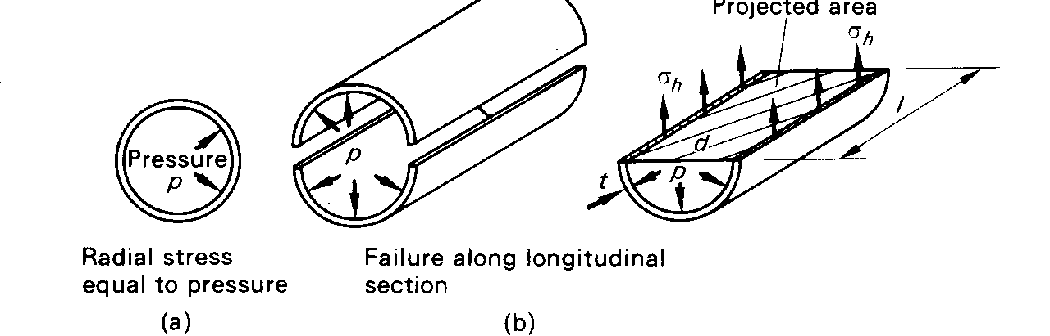
2.2.1 Hoop stress in thin cylindrical shell

Slide 13
Hoop stress in thin cylindrical shell Contd.
The internal pressure, p tends to increase the diameter of the cylinder and this produces a hoop or circumferential stress (tensile).
If the stress becomes excessive, failure in the form of a longitudinal burst would occur.

Slide 14
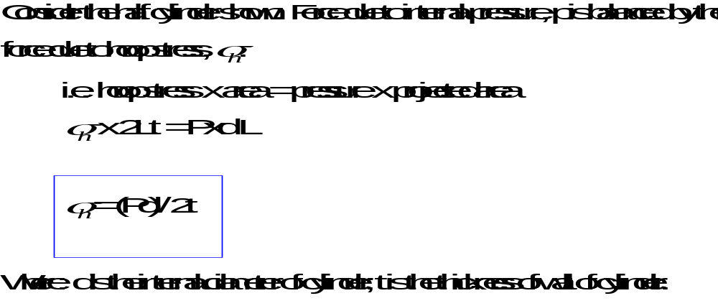
Hoop stress in thin cylindrical shell Concluded

Slide 15
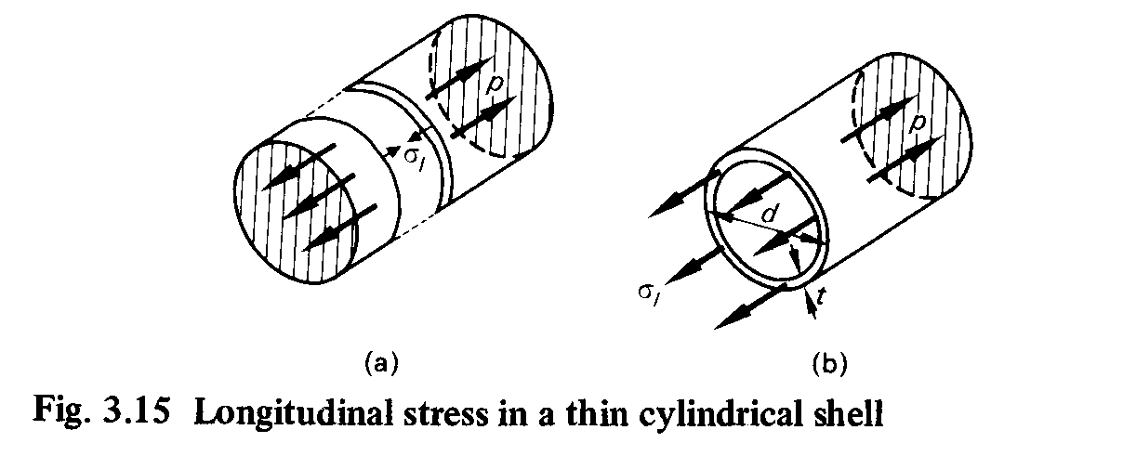
2.2.2. Longitudinal stress in thin cylindrical shell

Slide 16
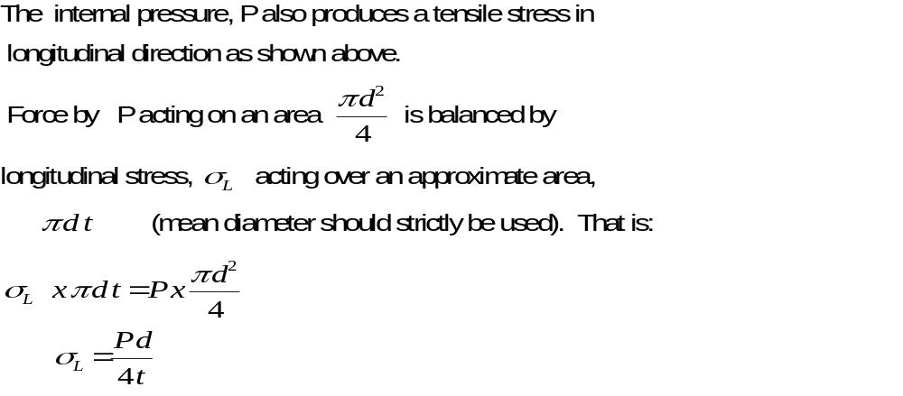
Longitudinal stress in thin cylindrical shell Contd.

Slide 17
Note
1. Since hoop stress is twice longitudinal stress, the cylinder would fail by tearing along a line parallel to the axis, rather than on a section perpendicular to the axis.
The equation for hoop stress is therefore used to determine the cylinder thickness.
Allowance is made for this by dividing the thickness obtained in hoop stress equation by efficiency (i.e. tearing and shearing efficiency) of the joint.

Slide 18
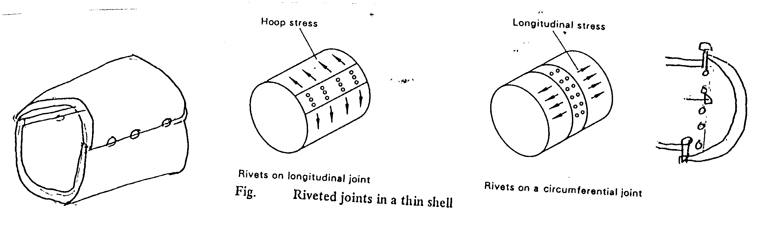
Longitudinal stress in thin cylindrical shell Concluded

Slide 19
Example
A cylindrical boiler is subjected to an internal pressure, p. If the boiler has a mean radius, r and a wall thickness, t, derive expressions for the hoop and longitudinal stresses in its wall. If Poisson’s ratio for the material is 0.30, find the ratio of the hoop strain to the longitudinal strain and compare it with the ratio of stresses.

Slide 20
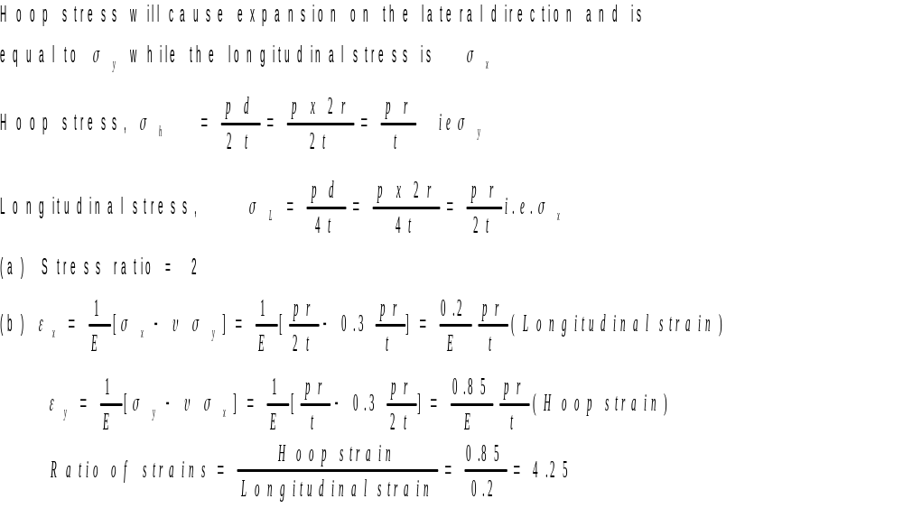
Solution

Slide 21
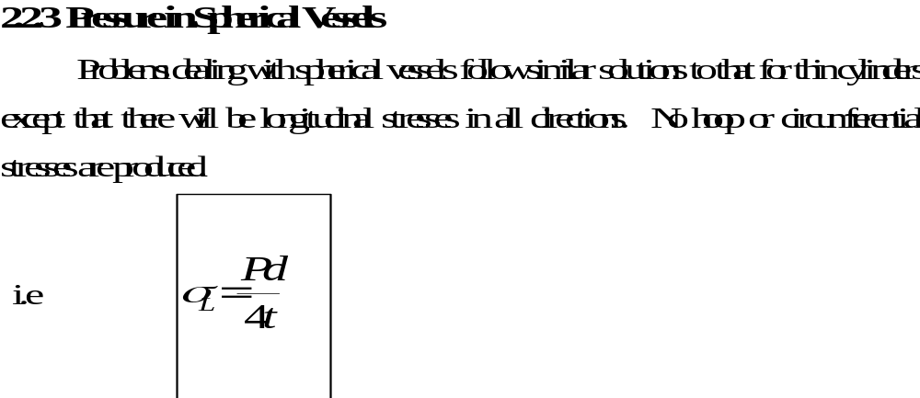
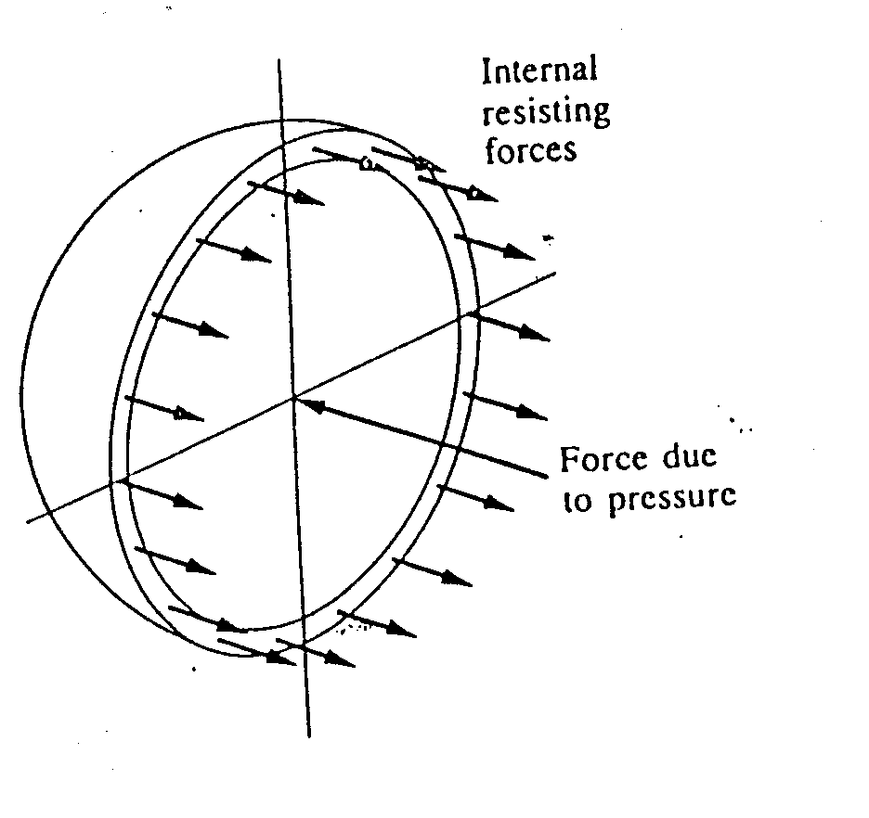
2.2.3 Pressure in Spherical Vessels

Slide 22
2.3 STRESSES IN THIN ROTATING RINGS
If a thin circular ring or cylinder, is rotated about its centre, there will be a natural tendency for the diameter of the ring to be increased.
A centripetal force is required to maintain a body in circular motion.
In the case of a rotating ring, this force can only arise from the hoop or circumferential stress created in the ring.

Slide 23
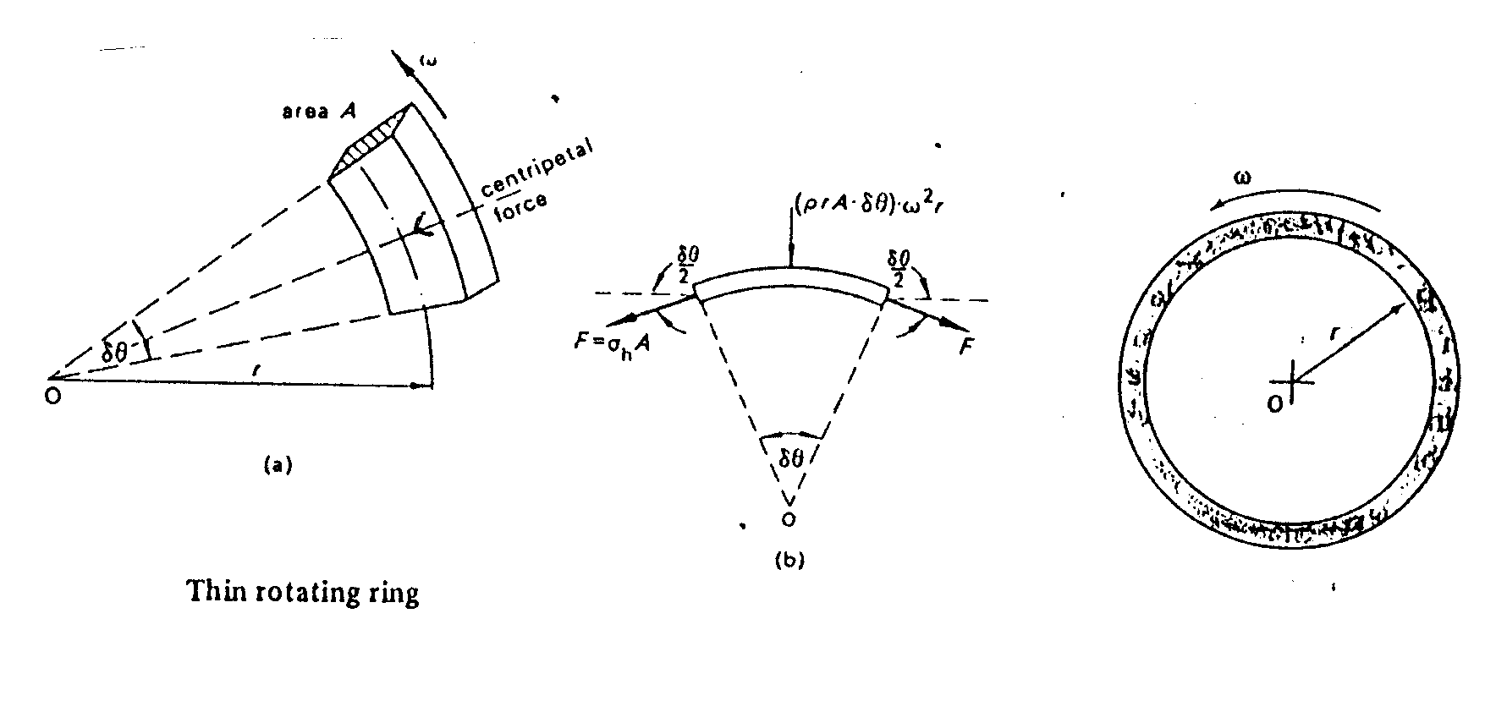
STRESSES IN THIN ROTATING RING

Slide 24
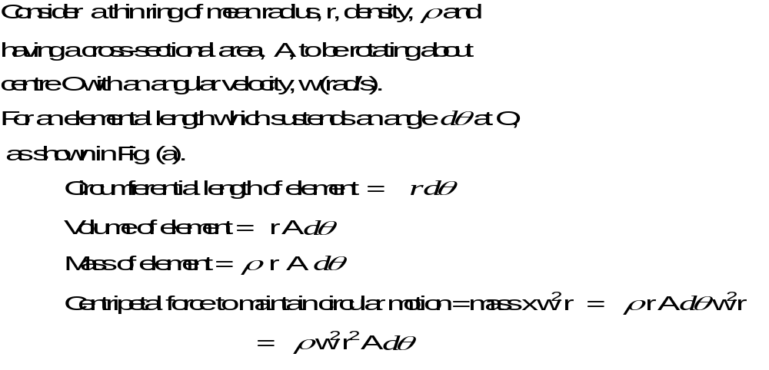
STRESSES IN THIN ROTATING RINGS CONTD.

Slide 25
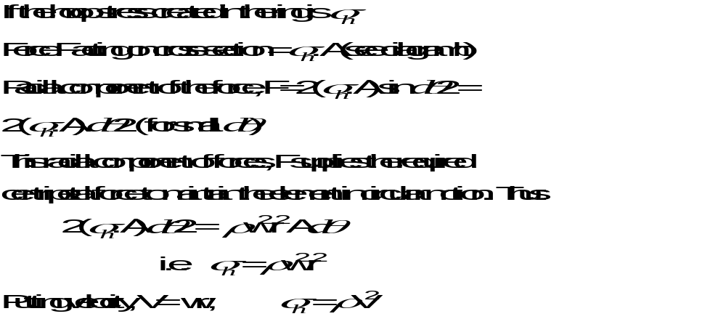
STRESSES IN THIN ROTATING RINGS CONTD.

Slide 26
STRESSES IN THIN ROTATING RINGS CONCLUDED
Hence: Hoop stress created in a thin rotating ring, or cylinder is independent of the cross-sectional area.
For a given peripheral speed, the stress is independent of the radius of the ring.

Slide 27
EXAMPLE
A thin steel plate having a tensile strength of 440 MN/m² and a density of 7.8 Mg/m³ is formed into a circular drum of mean diameter 0.8 m.
Determine the greatest speed at which the drum can be rotated if there is to be a safety factor of 8. E = 210 GN/m².

Slide 28
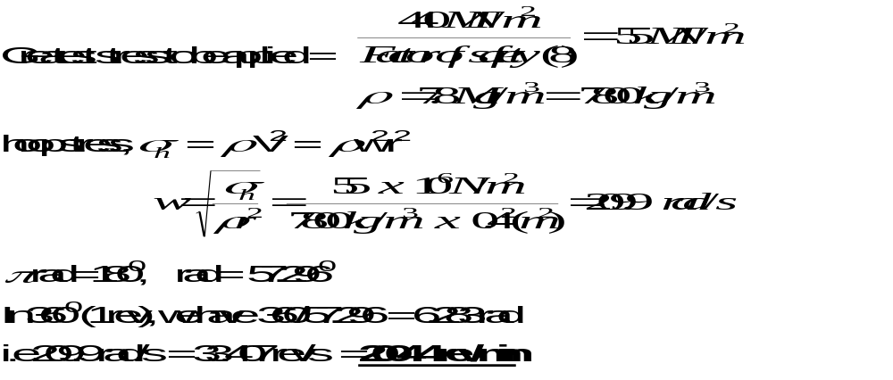
SOLUTION

Slide 29
2.4 STATICALLY INDETERMINATE STRESS SYSTEMS
There is the need to assess the geometry of deformation and link stress and strain through modulus and Poisson’s ratio for the material.

Slide 30
2.4.1 Volume Changes
Example: A pressure cylinder, 0.8 m long is made out of 5 mm thick steel plate which has an elastic modulus of 210 x 10³ N/mm² and a Poisson’s ratio of 0.28. The cylinder has a mean diameter of 0.3 m and is closed at its ends by flat plates. If it is subjected to an internal pressure of 3 N/mm², calculate its increase in volume.

Slide 31
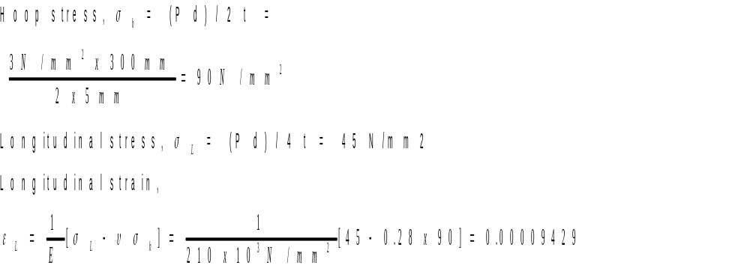
SOLUTION

Slide 32
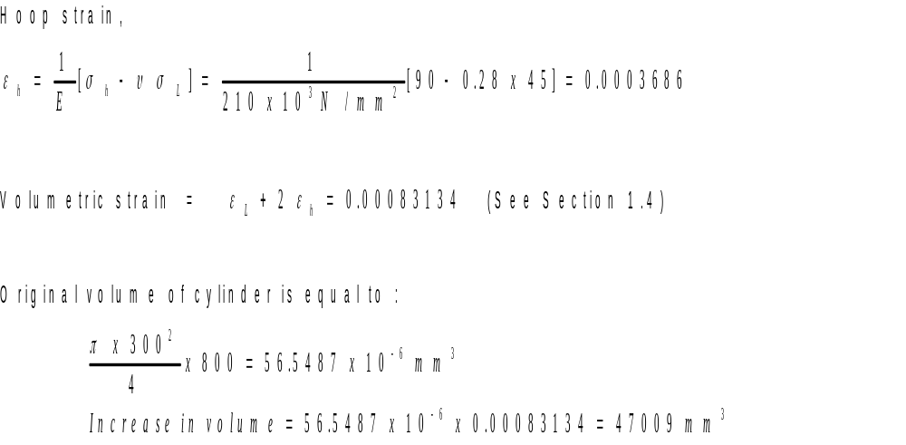
SOLUTION CONCLUDED

Slide 33
Example
The dimensions of an oil storage tank with hemispherical ends are shown in the Figure. The tank is filled with oil and the volume of oil increases by 0.1% for each degree rise in temperature of 1⁰C. If the coefficient of linear expansion of the tank material is 12 x 10⁻⁶ per ⁰C, how much oil will be lost if the temperature rises by 10⁰C.

Slide 34
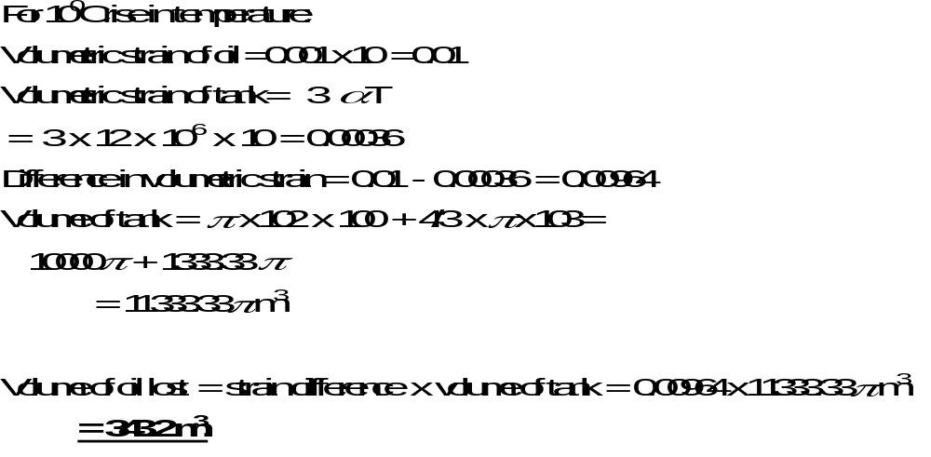
SOLUTION

Slide 35
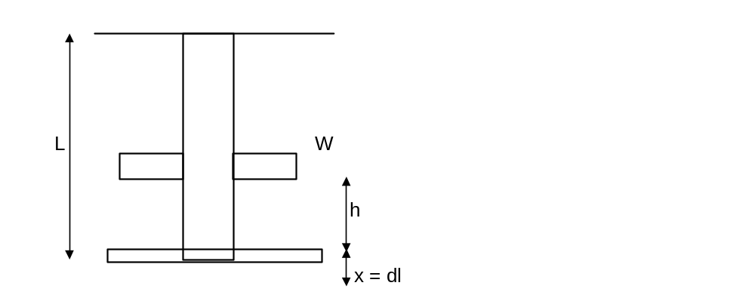
2.4.2 IMPACT LOADS

Slide 36
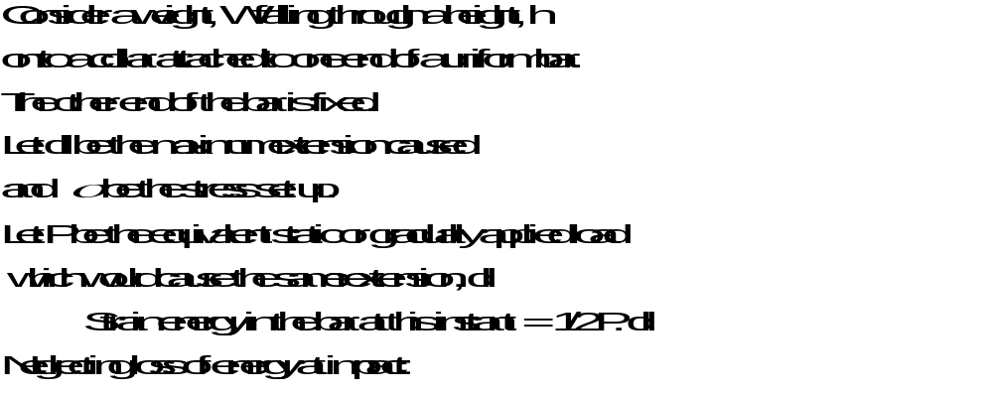
IMPACT LOADS CONTD.

Slide 37
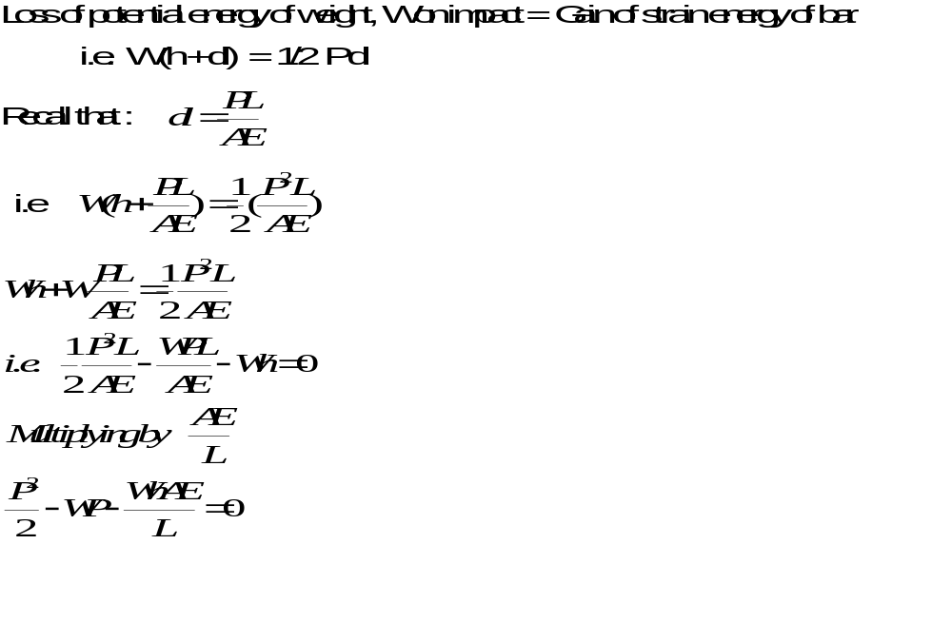
IMPACT LOADS CONTD.

Slide 38
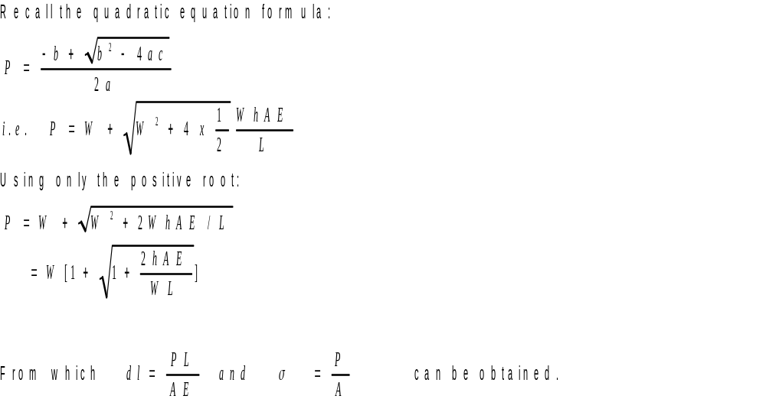
IMPACT LOADS CONTD.

Slide 39
IMPACT LOADS CONTD.
Note: 1. For a suddenly applied load , h = 0 and P = 2 W i.e the stress produced by a suddenly applied load is twice the static stress.
2. If there is no deformation, ‘ x’ of the bar, W will oscillate about, and come to rest in the normal equilibrium position.

Slide 40
IMPACT LOAD CONCLUDED
3. The above analysis assumes that the whole of the rod attains the same value of maximum stress at the same instant.
In actual practice, a wave of stress is set up by the impact and is propagated along the rod.
This approximate analysis, however, gives results on the “safe” side.

Slide 41
EXAMPLE
A mass of 100 kg falls 4 cm on to a collar attached to a bar of steel, 2 cm diameter, 3 m long.
Find the maximum stress set up. E = 205,000 N/mm².

Slide 42
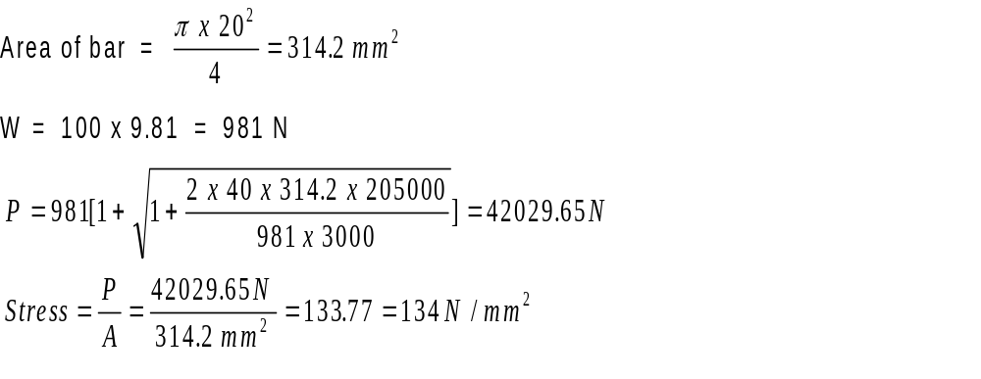
SOLUTION CONCLUDED

Slide 43
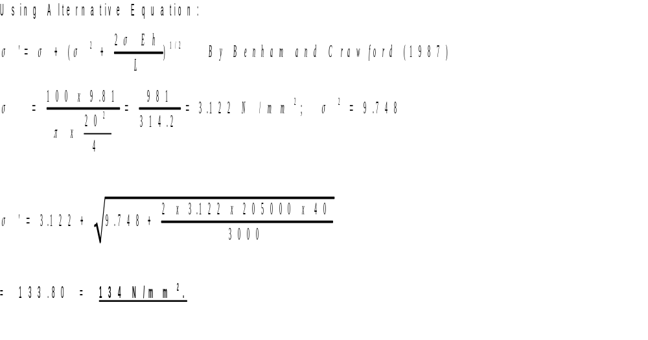
ALTERNATIVE SOLUTION

